Slide 1
Data Structures and Algorithms 21CSC201J
By
Ms. Nidhi Pandey
Assistant Professor
CSE Dept
SRMIST

Slide 2
Unit 1:
Primitive data types
Structures, Self-referential structures, Pointers
Dynamic memory allocation
Matrix multiplication
Data Structure – Definition, Types
ADT, Operations
Mathematical notations, Asymptotic Notations-Big O, Omega and Theta
Complexity – Time, Space, Trade off
Searching-Linear Search and Binary Search
Sorting-Insertion sort, Bubble sort.

Slide 3
Primitive data types
Primitive data types are the most basic data types that are used for representing simple values such as
Integers,
Float,
Characters
Double

Slide 4
Structures, Self-referential structures, Pointers
Structure is a user-defined data type that can be used to group items of possibly different types into a single type.
struct structure_name
{
data_type member_name1;
data_type member_name1; .... ....
};

Slide 5
Dynamic memory allocation
Dynamic memory allocation enables the C programmer to allocate memory at runtime
Dynamic memory allocation in c language is possible by 4 functions of stdlib.h header file.
malloc()
calloc()
realloc()
free()

Slide 6
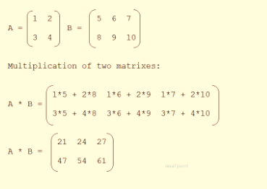
Matrix multiplication
Matrix is a 2D array of numbers arranged in rows and columns
Number of columns of the first matrix should be equal to the number of rows of the second matrix
Example:
/* Multiplication of Matrix
(int i = 0; i < 2; i++)
{ for (int j = 0; j < 2; j++)
{ C[i][j] = 0;
for (int k = 0; k < 3; k++)
{ C[i][j] += A[i][k] * B[k][j];
} } }

Slide 7
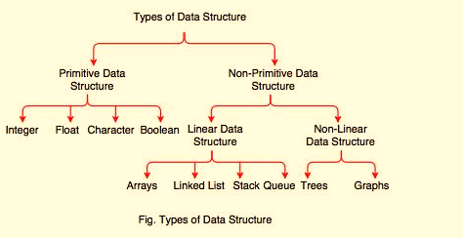
Data Structure – Definition, Types
A data structure is a particular way of organizing data in a computer so that it can be used effectively

Slide 8
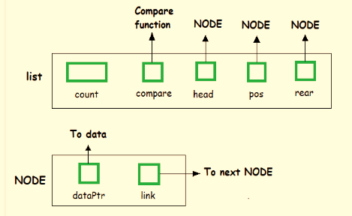
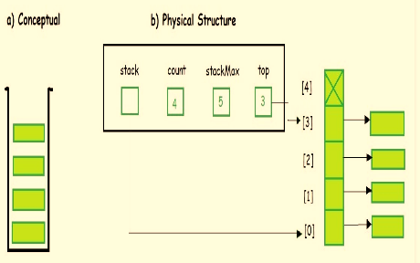
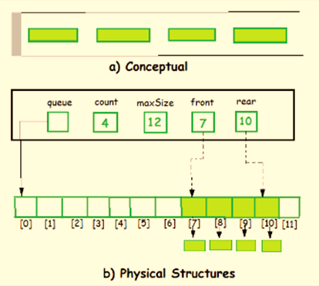
ADT
ADT as a black box which hides the inner structure and design of the data type
Examples of ADT are Stack, Queue, List
List ADT
Stack ADT
Queue ADT

Slide 9
Mathematical notations, Asymptotic Notations-Big O, Omega and Theta
Asymptotic notations are mathematical tools to represent time complexity of algorithms for asymptotic analysis. The following 3 asymptotic notations are mostly used to represent time complexity of algorithms.
Big Oh (O)
omega (Ω)
theta (Θ)

Slide 10
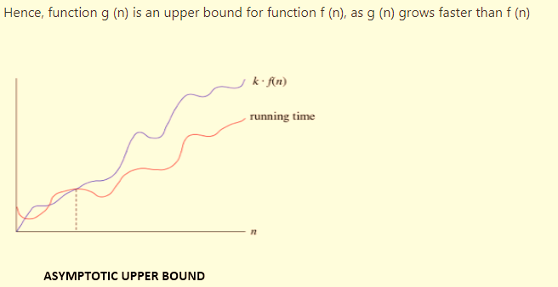
Big oh (O)
Big-oh notation: Big-oh is the formal method of expressing the upper bound of an algorithm's running time. It is the measure of the longest amount of time.
The function f (n) = O (g (n)) [read as "f of n is big-oh of g of n"] if and only if exist positive constant c and such that
f (n) ⩽ k.g (n) for n>n0n>n0 in all case

Slide 11
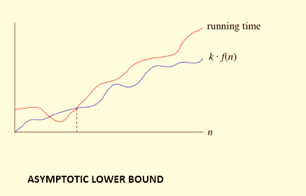
Omega (Ω) Notation
The function f (n) = Ω (g (n)) [read as "f of n is omega of g of n"] if and only if there exists positive constant c and n₀ such that
F (n) ≥ k* g (n) for all n, n≥ n₀

Slide 12
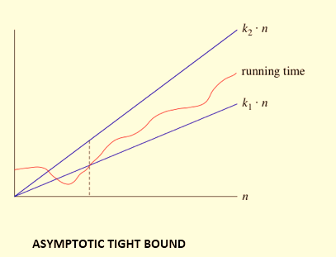
Theta (θ)
The function f (n) = θ (g (n)) [read as "f is the theta of g of n"] if and only if there exists positive constant k₁, k₂ and k₀ such that
k₁ * g (n) ≤ f(n)≤ k₂ g(n)for all n, n≥ n₀

Slide 13
Complexity – Time, Space, Trade off
The time complexity of an algorithm is a number of computer time needs in execution to complete.
The rules for computing running time
1. Sequence
2. Alternative structures
3. Loops
4. Nested loops
5. Subprograms
6. Recursive Subprograms

Slide 14
The space complexity is the amount of space (memory) is needed for an algorithm to solve the problem. An efficient algorithm takes space as small as possible.
Space needed by a program is the sum of the following components:
1. Instruction space
2. Data Space
a) Space needed by constants and simple variables. This space is fixed.
b) Space needed by fixed sized structured variables, such as arrays and structure.
c) Dynamically allocated space from memory pool called heap. This space usually varies.
3. In-build stack space

Slide 15
There are three types of time complexities, which can be found in the analysis of an algorithm:
1. Best case time complexity: measure of the minimum time that the algorithm will require
2. Average case time complexity: measure of average time of all instances taken by an algorithm
3. Worst case time complexity: measure of the maximum time that the algorithm will require

Slide 16
Time-Space Trade-Off
Space-Time tradeoff in computer science is basically a problem solving technique in which we solve the problem:
Either in less time and using more space,
In very little space by spending more time
Types of Time-Space Trade-Off
Lookup tables or Recalculation
Compressed or Uncompressed data
Re Rendering or Stored images
Smaller code or loop unrolling

Slide 17

Searching-Linear Search and Binary Search
Consider an array that is sorted in increasing order
We have to search a given number in this array and report whether it’s present in the array or not
In this case, we have two algorithms, and we will be interested in analyzing their performance separately
Linear Search
Binary search

Slide 18
Linear Search – Start from the first element until an element greater than or equal to the number to be searched is found
# Input: Array D, integer key
# Output: first index of key in D, or -1 if not found
For i = 0 to last index of D:
if D[i] == key:
return i
return -1

Slide 19
Analyzing Algorithm 1: (Linear Search)
Best case complexity = O(1)
Worst-case complexity = O(n)
Average case complexity = O(n)

Slide 20
Analyzing Algorithm 2: (Binary Search)
This searching technique keep dividing the array until we find an element and making it faster to search
binarysearch(a[n], key, low, high)
while(low<high)
{
mid = (low+high)/2;
if(a[mid]=key)
return mid;
elseif (a[mid]>key)
high=mid-1;
else
low=mid+1;
}
return -1;

Slide 21
Complexity Analysis
Best Case Time Complexity : O(1).
Average Case Time Complexity: O(logn)
Worst Case Time Complexity: O(logn).

Slide 22
Sorting-Insertion sort, Bubble sort.
Given an array
x[0], x[1], … , x[size-1]
reorder entries so that
x[0] <= x[1] <= . . . <= x[size-1]
Here, List is in non-decreasing order.
We can also sort a list of elements in non-increasing order

Slide 23
Many issues are there in sorting techniques
How to rearrange a given set of data?
Which data structures are more suitable to store data prior to their sorting?
How fast the sorting can be achieved?
How sorting can be done in a memory constraint situation?
How to sort various types of data?

Slide 24
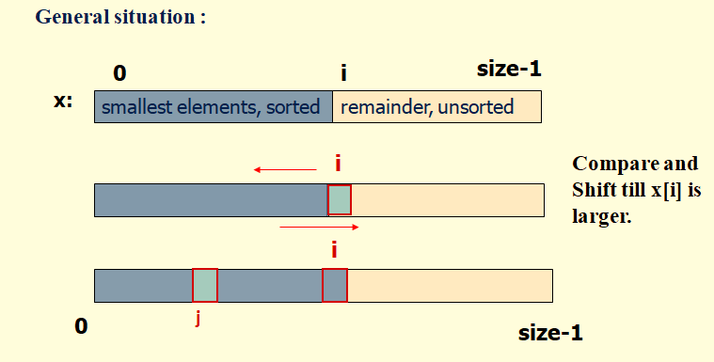
Basic operation involved in this type of sorting technique is comparison. A data item is compared with other items in the list of items in order to find its place in the sorted list.
Insertion sort

Slide 25
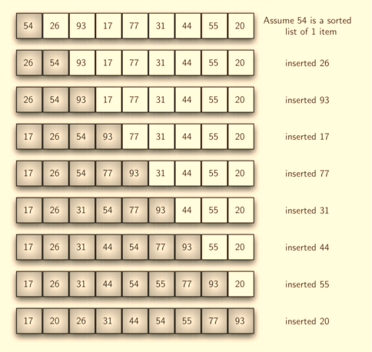
Insertion sort-Example
From a given list of items, one item is considered at a time. The item chosen is then inserted into an appropriate position relative to the previously sorted items. The item can be inserted into the same list or to a different list

Slide 26
Insertion Sort: Complexity Analysis
Worst Case Time Complexity [ Big-O ]: O(n²)
Best Case Time Complexity [Big-omega]: O(n)
Average Time Complexity [Big-theta]: O(n²)

Slide 27
Bubble Sort-
Bubble sort is the easiest sorting algorithm to implement.
It is an in-place sorting algorithm.
It uses no auxiliary data structures (extra space) while sorting
How Bubble Sort Works?
Bubble sort uses multiple passes (scans) through an array.
In each pass, bubble sort compares the adjacent elements of the array.
It then swaps the two elements if they are in the wrong order.
In each pass, bubble sort places the next largest element to its proper position.
In short, it bubbles down the largest element to its correct position

Slide 28
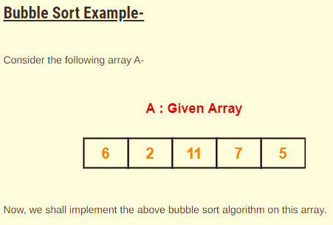

Slide 29
Complexity Analysis
Best Case= O(n)
Worst Case = O(n x n)
Average Case= O (n x n).

Slide 30
Thank you

